Slide 1
Database Systems
Lecture 9
Types of Attributes, Entity Types, Entity Sets, Keys, and Value Sets

Slide 2
Today’s agenda
Types of Attributes
Entity types
Entity sets
Key attributes

Slide 3
Types of Attributes
Several types of attributes occur in the ER model:
simple versus composite
single-valued versus multivalued
stored versus derived.
Complex attributes
Null values

Slide 4
Composite versus Simple (Atomic) Attributes
Composite attributes can be divided into smaller subparts which represent more basic attributes with independent meanings
For example, the Address attribute of the employee entity can be subdivided into StreetAddress, City, State, and Zip,
Attributes that are not divisible are called simple or atomic attributes.

Slide 5
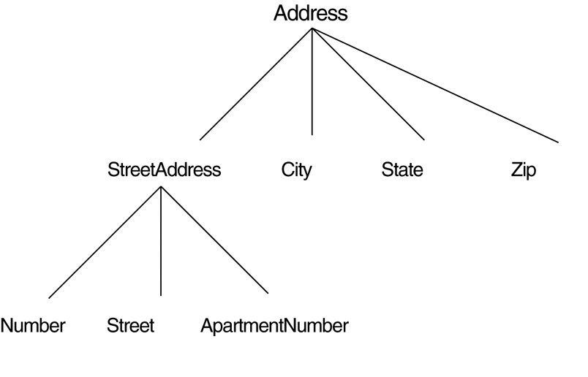
A hierarchy of composite attributes

Slide 6
Single-Valued versus Multivalued Attributes.
Most attributes have a single value for a particular entity; such attributes are called single-valued.
For example, Age is a single-valued attribute of a person.
In some cases an attribute can have a set of values for the same entity_ For example, a Colors attribute for a car, or a CollegeDegrees attribute for a person.
Such attributes are called multivalued.
Multivalued attributes may have lower and upper bounds to constrain the no-of values allowed for each individual entity.

Slide 7
Stored versus Derived Attributes
In some cases, two (or more) attribute values are related-for example, the Age and BirthDate attributes of a person.
The Age attribute is hence called a derived attribute and is said to be derivable from the BirthDate attribute, which is called a stored attribute.
Some attribute values can be derived from the related entities such as no-of employees of a department entity can be derived by counting no-of employees related to that department.

Slide 8
Null Values
In some cases a particular entity may not have an applicable value for an attribute.
For example, the Apartment_number attribute of an address applies only to addresses that are in apartment buildings and not to other types of residences. Other example is college_degrees
For such situations, a special value called null is created.
Null can also be used if we do not know the value of an attribute for a particular entity such as phone # of a person

Slide 9
Unknown Values
The meaning of the former type of null is not applicable, whereas the meaning of the latter is unknown.
The "unknown" category of null can be further classified into two cases.
The first case arises when it is known that the attribute value exists but is missing-for example, if the Height attribute of a person is listed as null.
The second case arises when it is not known whether the attribute value exists-for example, if the HomePhone attribute of a person is null.

Slide 10
Complex Attributes
Composite and multivalued attributes can be nested in an arbitrary way.
We can represent arbitrary nesting by grouping components of a composite attribute between parentheses () and separating the components with commas, and by displaying multivalued attributes between braces {}
Such attributes are called complex attributes.

Slide 11

A complex attribute: AddressPhone.

Slide 12
Entity Types
Entities with the same basic attributes are grouped or typed into an entity type. For example, the EMPLOYEE entity type or the PROJECT entity type.
An entity type defines a collection (or set) of entities that have the same attributes.
Each entity type in the database is described by its name and attributes.

Slide 13
Entity Sets
The collection of all entities of a particular entity type in the database at any point in time is called an entity set
Entity set is usually referred to using the same name as the entity type.
For example, all employees of an organization form an entity set. Like all students, all courses, all of them form entity set of different entity types

Slide 14
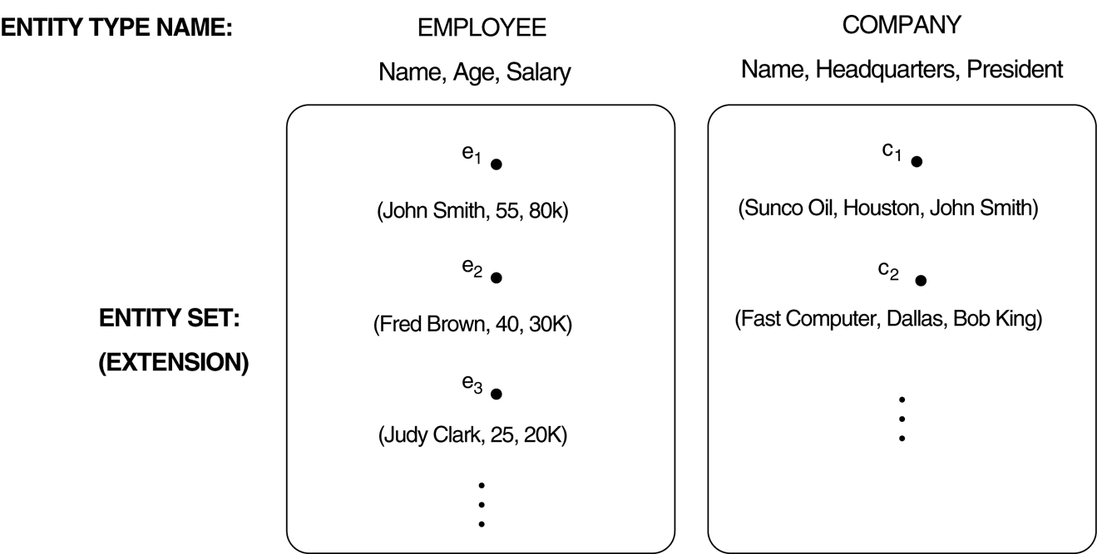
Two entity types, EMPLOYEE and COMPANY, and some member entities of each
The collection of entities of a particular entity type are grouped into an
entity set, which is also called the extension of the entity type.

Slide 15
Key Attributes of an Entity Type
An important constraint on the entities of an entity type is the key or uniqueness constraint on attributes.
An entity type usually has an attribute whose values are distinct for each individual entity in the entity set.
Such an attribute is called a key attribute, and its values can be used to identify each entity uniquely

Slide 16
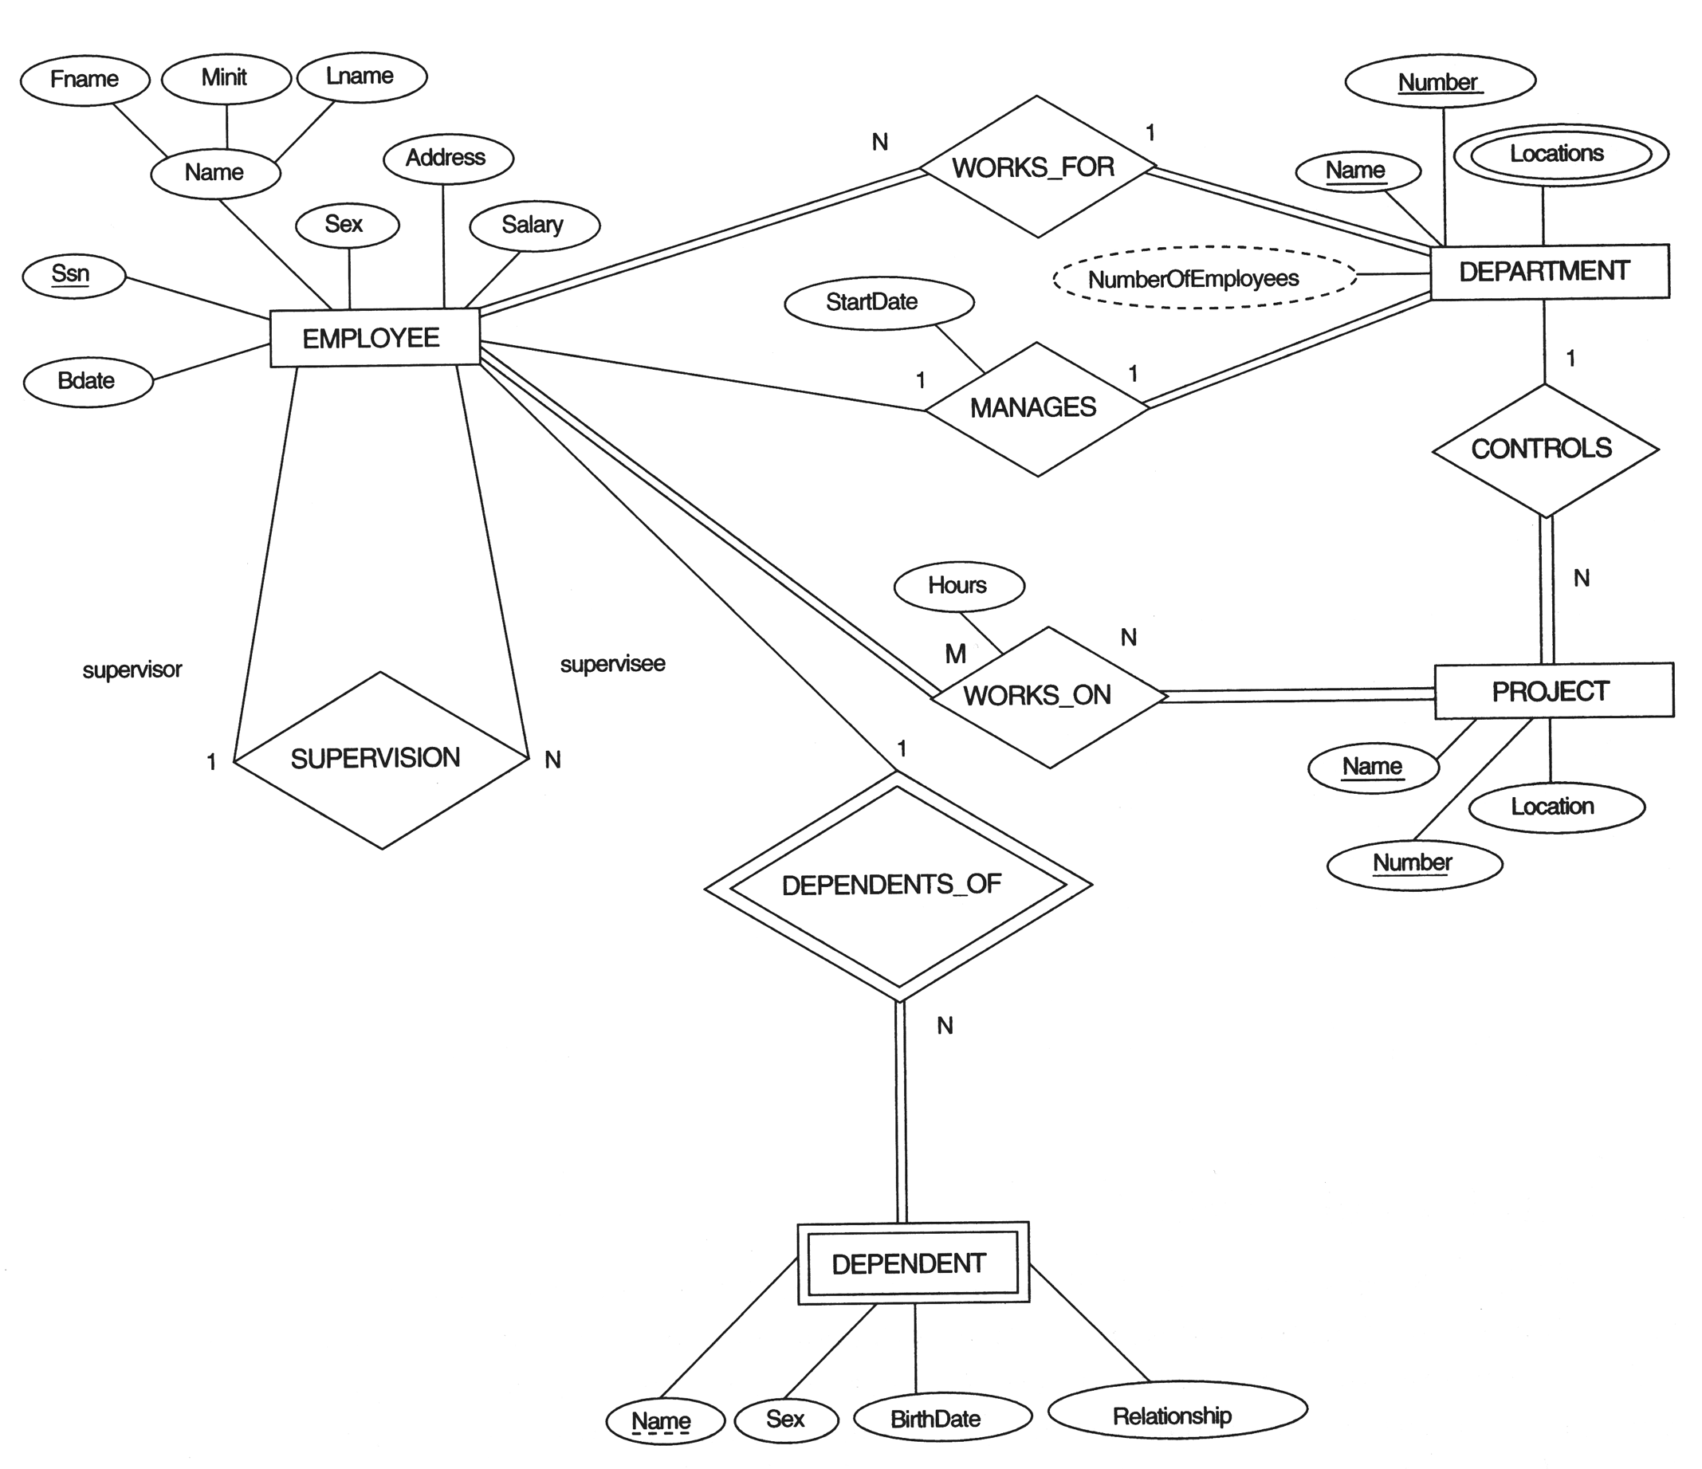

Slide 17
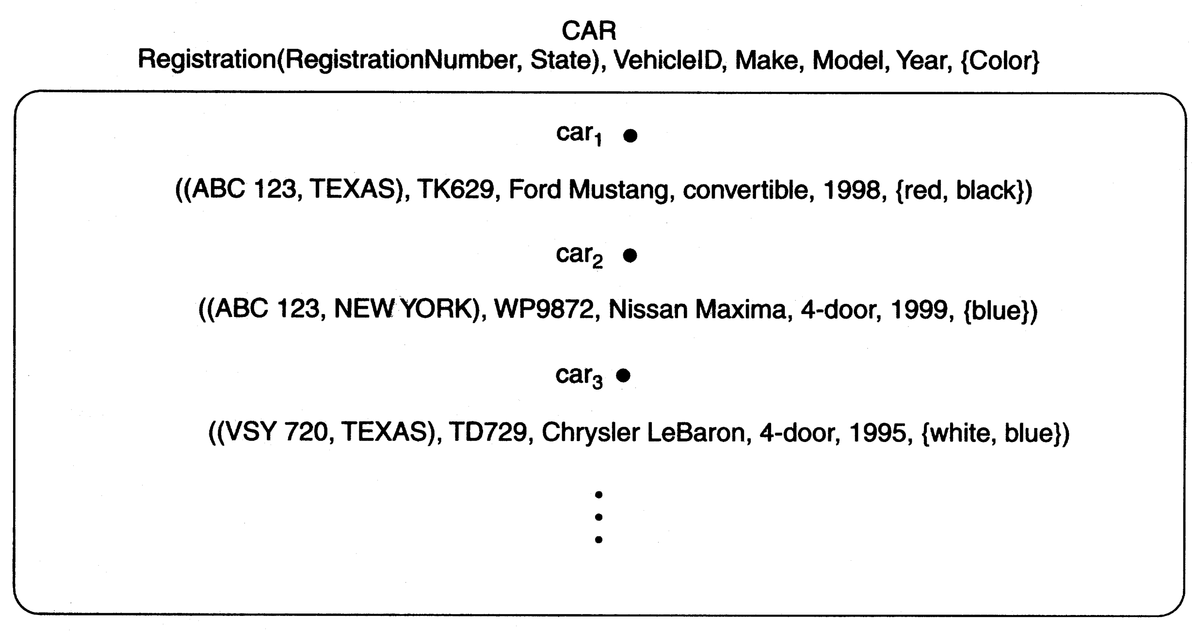
A key attribute may be composite. For example, VehicleTagNumber is a key of the CAR entity type with components (Number, State).

Slide 18
Value Sets (Domains) of Attributes
Each simple attribute of an entity type is associated with a value set (or domain of values),
This specifies the set of values that may be assigned to that attribute for each individual entity.
Value sets are typically specified using the basic data types such as integer, float, string, etc.,
For example, if the range of ages allowed for employees is between 16 and 70, we can specify the value set of the Age attribute of employee to be set of integer numbers between 16 and 70.
Value sets are not displayed in the ER diagram.

Slide 19
Weak Entity and Strong Entity
Weak entity is an entity type whose instances cannot exist without being linked with instances of some other entity type, i.e., they cannot exist independently.
An entity type whose instances can exist independently, that is, without being linked to the instances of any other entity type is called strong entity type.

Slide 20
Preliminary design of entity types for the COMPANY database

Slide 21
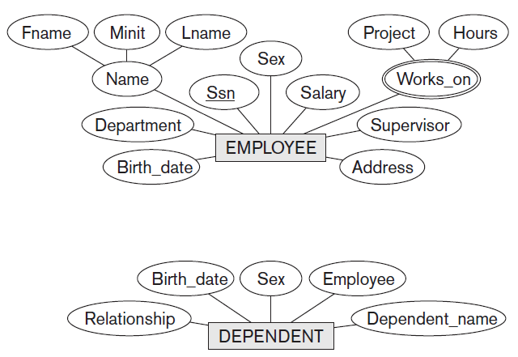
Preliminary design of entity types for the COMPANY database

Slide 22
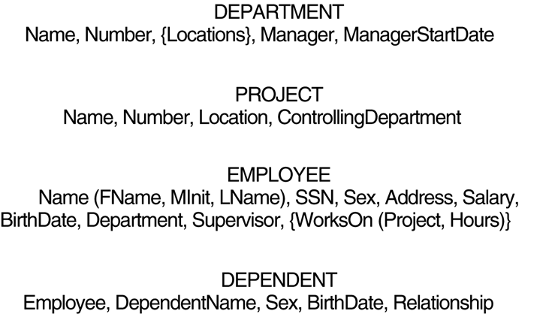
Preliminary design of entity types for the COMPANY database

